Slide 1
Motivation/context
Overview including human relation
???
Inverse perspective mapping (Camera lens distortion correction)
Road surface detection
Probabilistic histogram
Local orientation
Hough
Feature matching
Probabilistic Model matching
Optical flow
Confirmed by model matching
Path curve matching
Bezier curve path modelling

Slide 2
Put in a fun little bit here

Slide 3
Original scope
Intersection detection from still image
Restrictions
No other vehicles
Detectable road surface
Extension
Driving line confirmation and intersection tracking

Slide 4
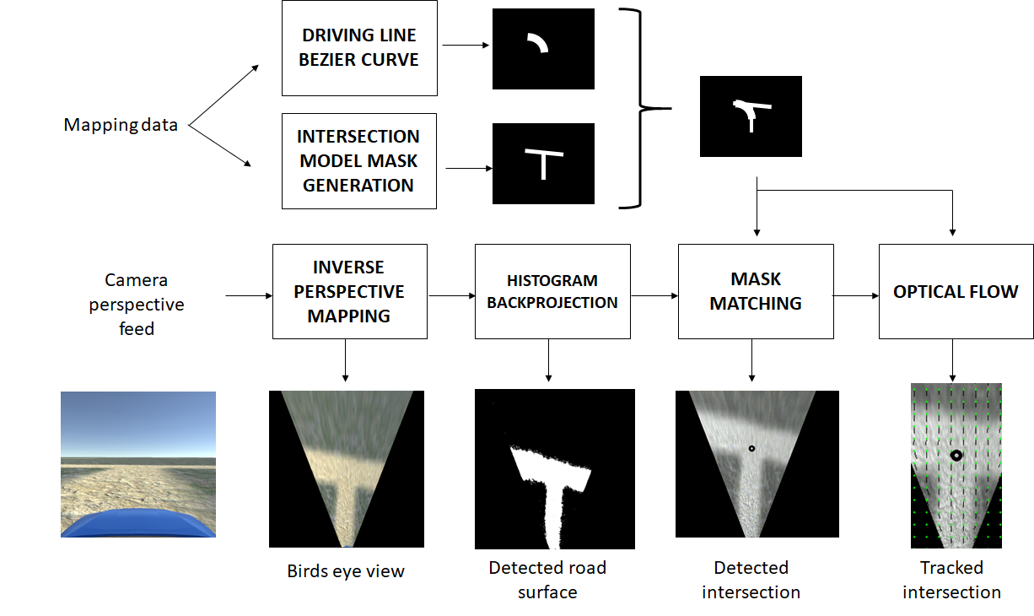

Slide 7
IPM

Slide 8
IPM

Slide 9
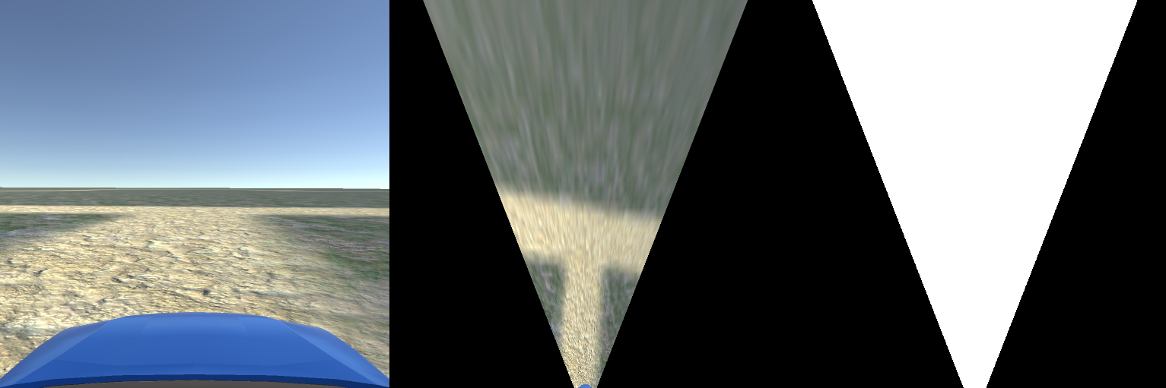
IPM
5m
5m
100px

Slide 12
Histogram Backprojection
IPM with box

Slide 15
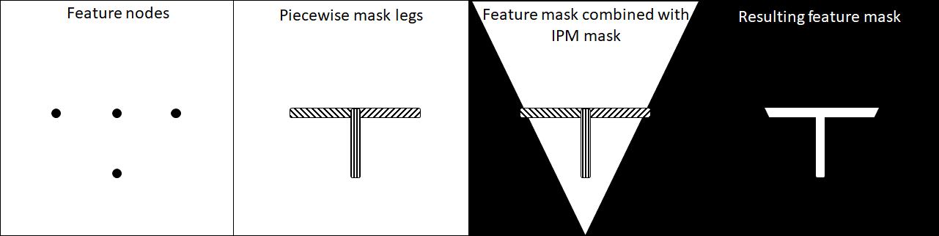
Feature mask generation

Slide 18
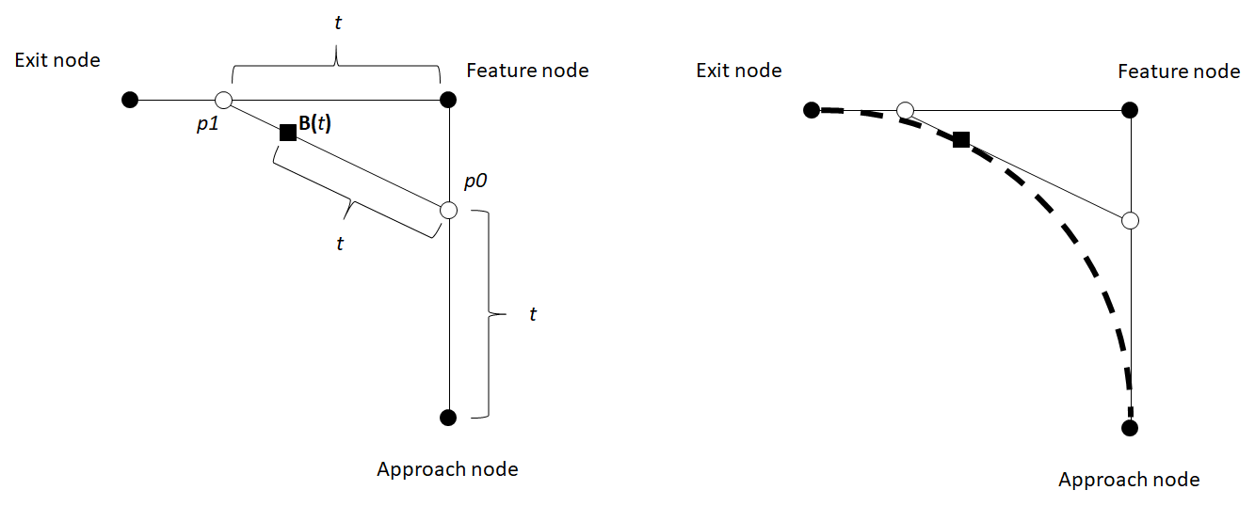
Driving line generation

Slide 22
Mask Matching
Find a wy to articulate this quickly

Slide 25
Optical flow
Single pixel eg
IPM Box eg

Slide 26
Optical flow
(2,3)

Slide 27
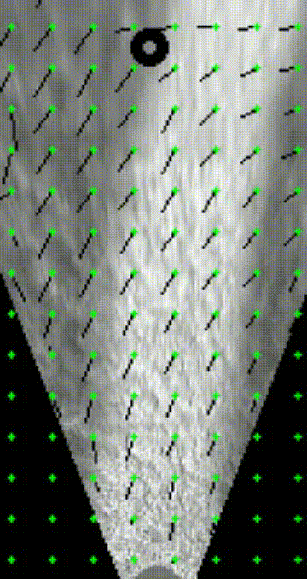
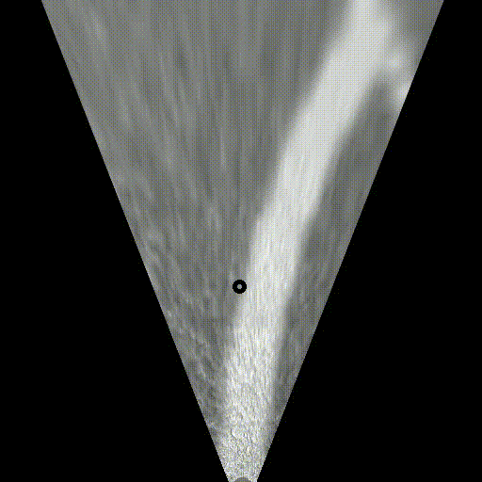
Optical flow

Slide 29
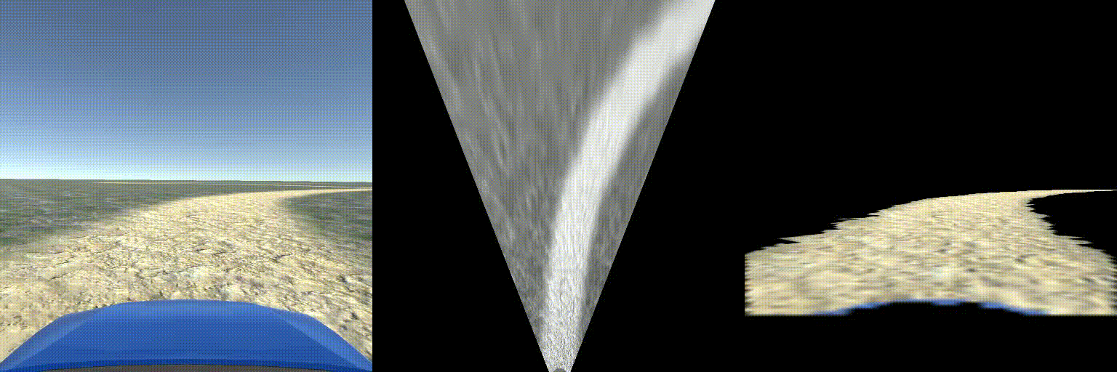

Slide 30
QUESTIONS

Slide 31
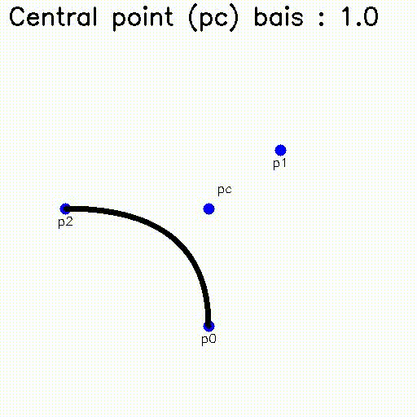
Path matching
Bezier curve theory
Interpolation between central point as p1 vs pc

Slide 32
Optical flow
Two-Frame Motion Estimation Based on Polynomial Expansion
Gunnar Farnebäck
http://www.diva-portal.org/smash/get/diva2:273847/FULLTEXT01.pdf

Slide 33
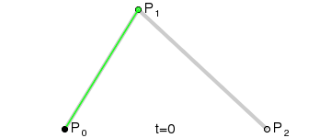
Bezier Curves

